Slide 1
Continuous Autoregressive Language Models (CALM)
Authors: Chenze Shao, Darren Li, Fandong Meng, Jie Zhou

Slide 2
Motivation: Limitation of Current Transformer
Token-by-token generation
- Sequential bottleneck: slow inference
Existing Solutions
- Non-autoregressive LM: the multimodality problem
- Multi-token prediction: multiple output layers
- Diffusion LM: long “diffusion” steps

Slide 3
Key Idea
Replace “tokens” by “vector”:
- token → chunk → vector
- fewer generation steps
- “vectors” shall be continuous!

Slide 4
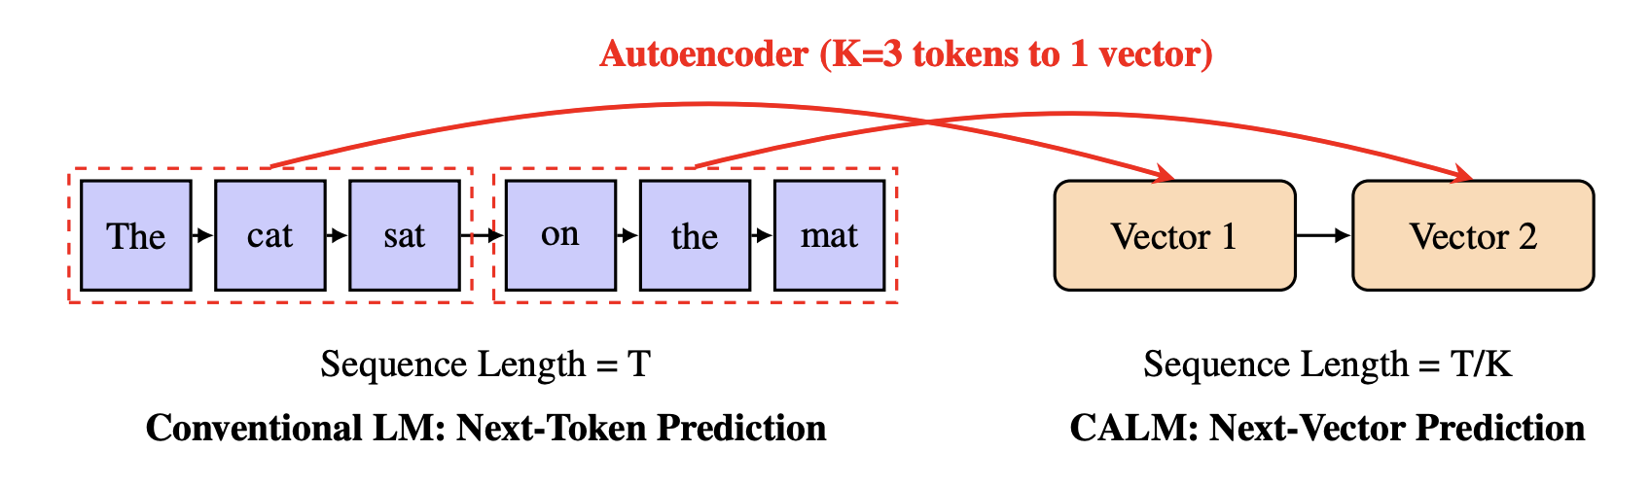
From Tokens to Vectors
K tokens → 1 vector
sequence length ↓ to 1/K

Slide 5
Overall Architecture
Training Components:
────────────────────
1. AutoEncoder:
x → Encoder → z → Decoder → x̂
2. Transformer: handles context information
- Transformer(z, h_{i-1}) = h_{i}
3. Generative Head:
- predict the next vector: p(z_{i} | h_{i-1}) → q(z_{i} | x)
- stochastic via noise ε
Workflow:
──────────
h_{i-2} → Transformer → h_{i-1} → Generative Head → z_{i} → Decoder → x_{i}
↑
x_{i-1} → z_{i-1}

Slide 6
AutoEncoder
Token chunk ↔ vector
x→z→x’
Problem: brittle discrete representation
- Model brings noise; “inaccurate” decodings are meaningless
Solution: Variational Autoencoder (VAE)
z ∼ N(μ,σ²)

Slide 7
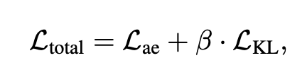
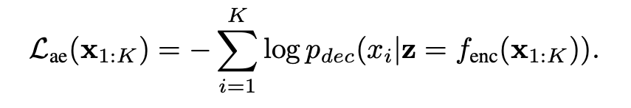
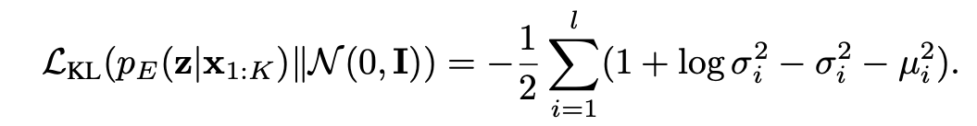
AutoEncoder: Loss
Tricks:
Preventing Posterior Collapse: Set minimal L_{KL} in each dimension
Dropout for Enhanced Robustness.

Slide 8
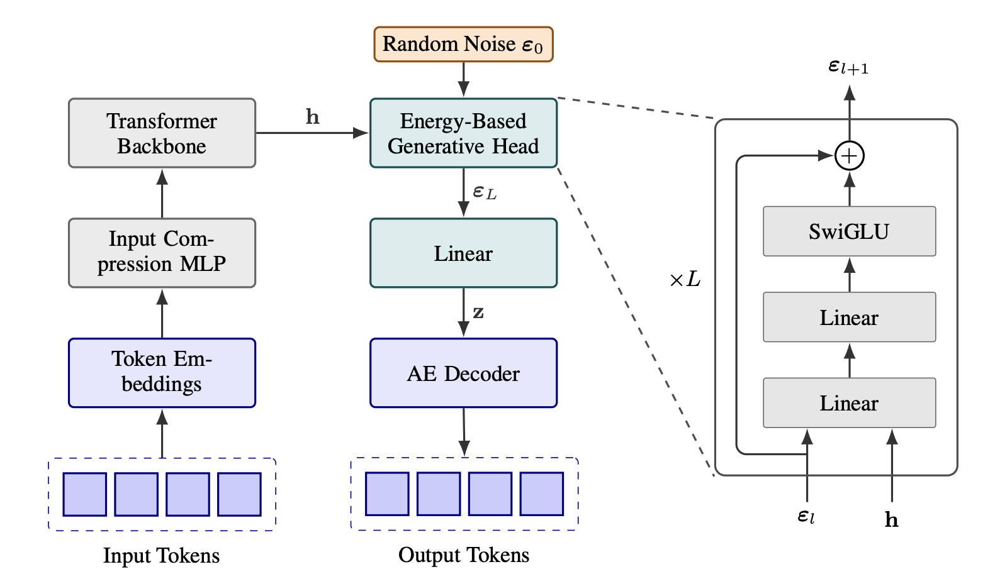
Generative Head (Replaces Likelihood Sampling)

Slide 9
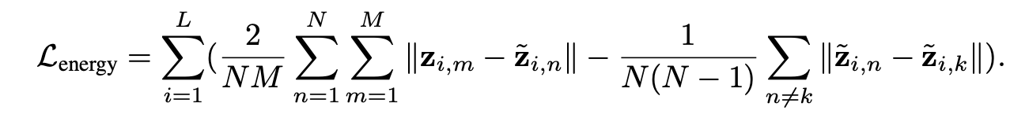
Generative Head
We want single-step generation for z
Energy Score: Fidelity & Diversity
Monte Carlo
- N candidate samples
- M samples from “ground-truth” in autoencoder

Slide 10
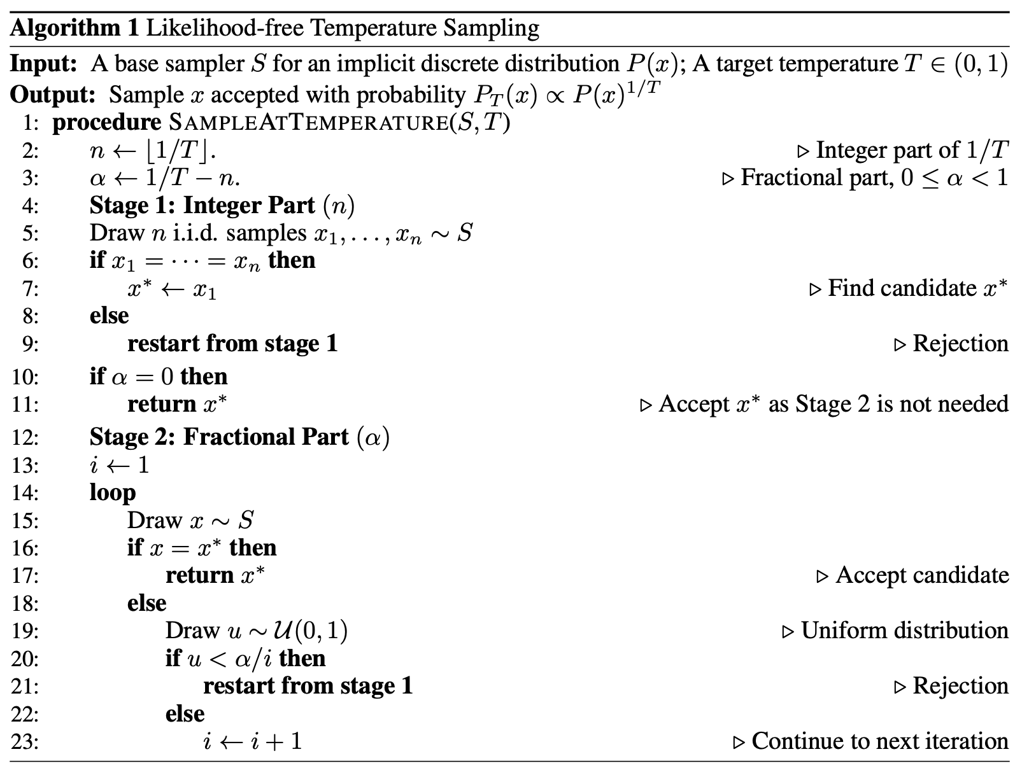
Support for Temperature

Slide 11
Evaluating CALM
No vector-level likelihood
So metrics like perplexity are undefined
Monte Carlo Again

Slide 12
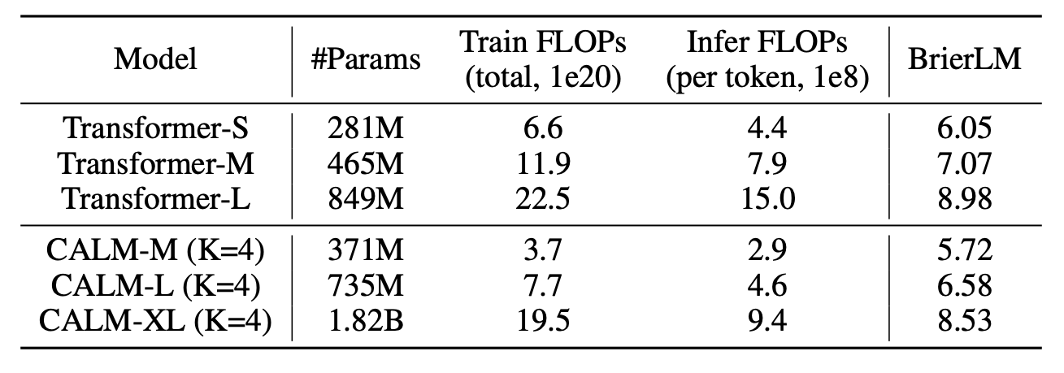
Result: Computational Cost of CALM

Slide 13
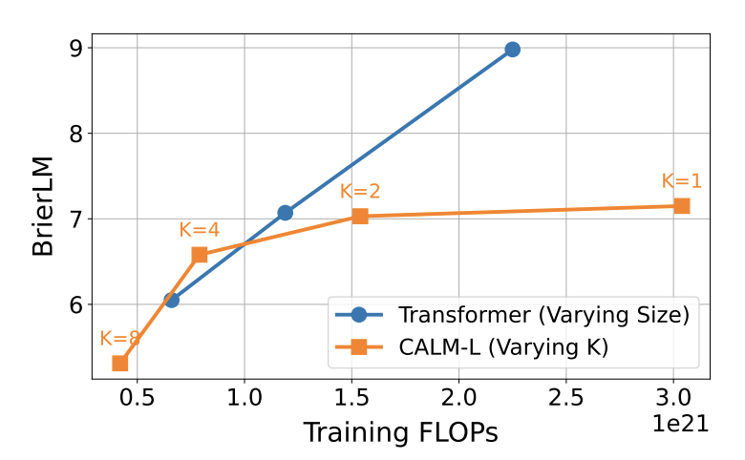
Result: Choice of Chunk Size

Slide 14
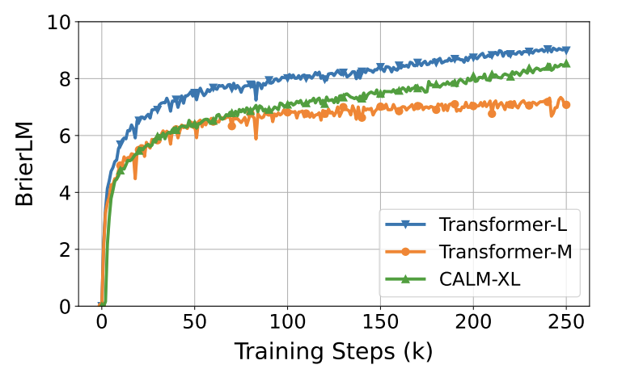
Result: Training Progress

Slide 15
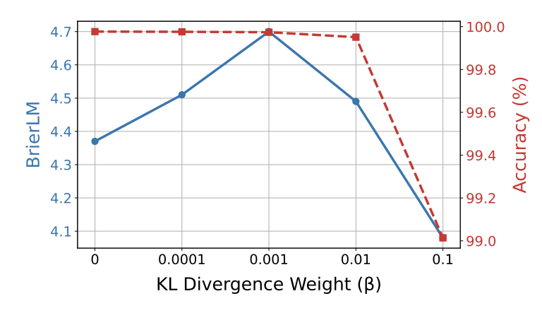
Result: Weight of “Normalization” in Encoder

Slide 16
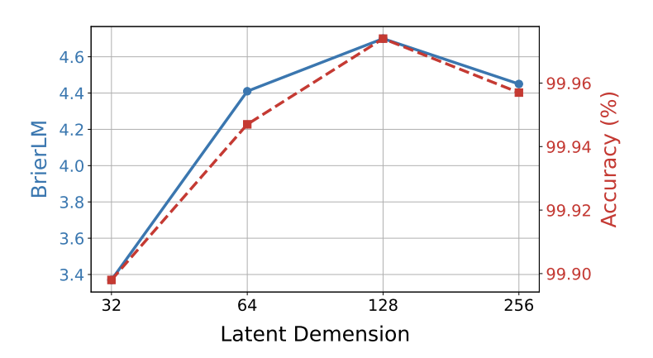
Result: Latent Dimension in Encoder

Slide 17
Strength & Limitations
Strength: More efficient
- Fewer generation steps
Limitations
- No Likelihood in generation
- Evaluation Overhead (Monte Carlo)
- Loop-based Temperature Design has edge cases

Slide 18
Future Work
Stronger Encoder
- Capture token relationships
Support likelihood-base techniques
- RL
- Distillation
- …

